Slide 1

Project#2 CNN
資工四 邱信瑋 410785018

Slide 2
Outline
Compare BP and CNN accuracy on MNIST
My CNN Model
Hyperparameters Setting and Data Processing
Whether do image processing
Whether do reducing learning rate
Different Batch size

Slide 3
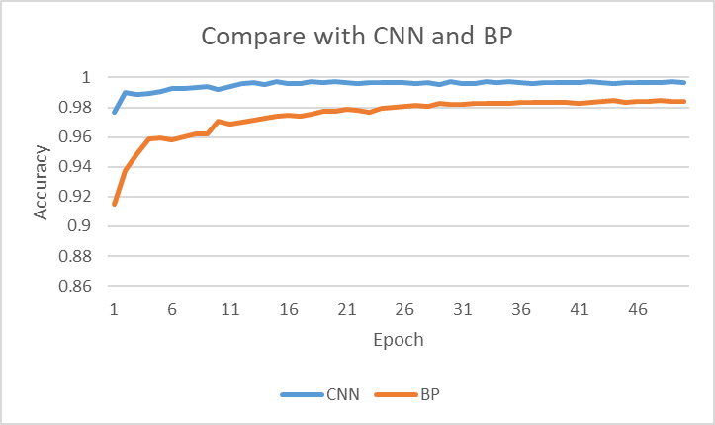
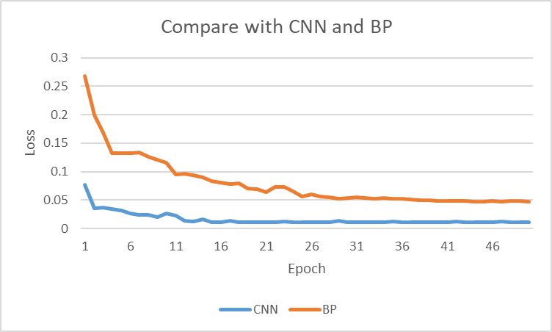
Compare BP and CNN accuracy on MNIST
Accuracy => CNN = 99.64,
BP = 98.44
CNN is obviously better than BP

Slide 4
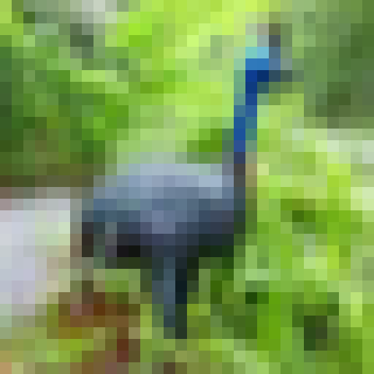
My CNN Model
Do BatchNormalization() after every convolution
Hidden nodes
n = 512
Output nodes
0
Image size = (32, 32)
1
100
nodes
3x3 conv, 128
MaxPooling2D (2X2)
Dropout(0.3)
MaxPooling2D (2X2)
Dropout(0.3)
MaxPooling2D (2X2) Dropout(0.3)
MaxPooling2D (2X2) Dropout(0.3)
2
3x3 conv, 128
3x3 conv, 256
3x3 conv, 256
3x3 conv, 512
3x3 conv, 512
3x3 conv, 512
3x3 conv, 512
3x3 conv, 512
.
.
.
.
.
.
100

Slide 5
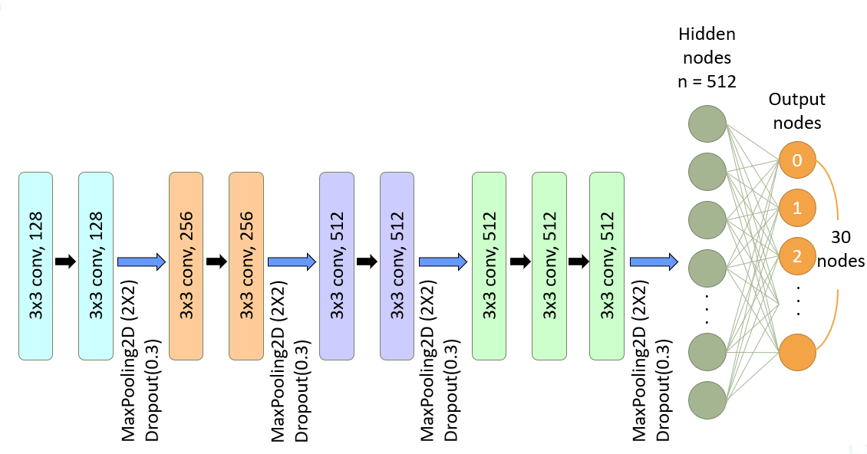
Hyperparameters Setting and Data Processing
Data Processing
ImageDataGenerator() -> rescale=1/255、 width_shift_range…
Hyperparamters Setting
Network Structure
BatchNormalization()
Dropout()
Optimizer -> Adam
ReduceLROnPlateau()
Batch size
No need to use rotation (the accuracy will be reduced instead in CIFAR-100 dataset)
30
Do BatchNormalization() after every convolution

Slide 6
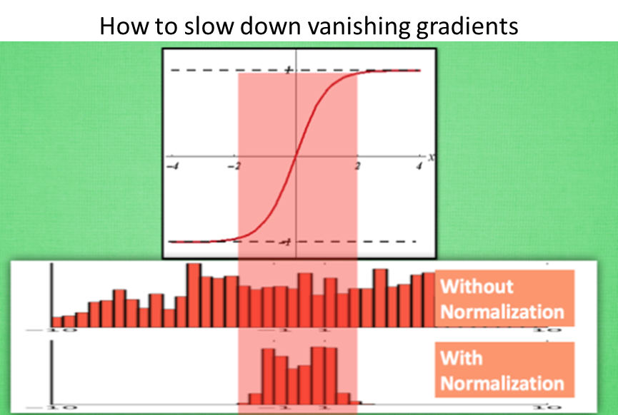
Hyperparameters Setting and Data Processing
Data Processing
ImageDataGenerator() -> rescale=1/255、 width_shift_range…
Hyperparamters Setting
Network Structure
BatchNormalization()
Dropout()
Optimizer -> Adam
ReduceLROnPlateau()
Batch size
No need to use rotation (the accuracy will be reduced instead in cifar 100 dataset)
slow down vanishing gradient
30

Slide 7
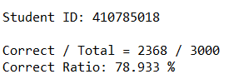
Accuracy (Demo)

Slide 8
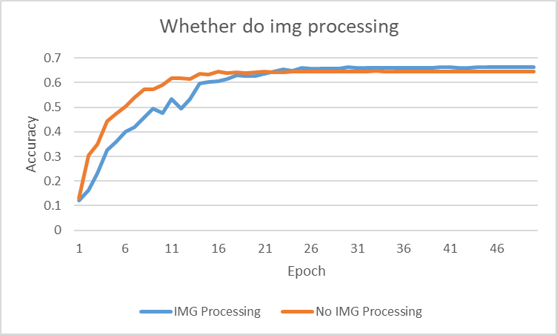
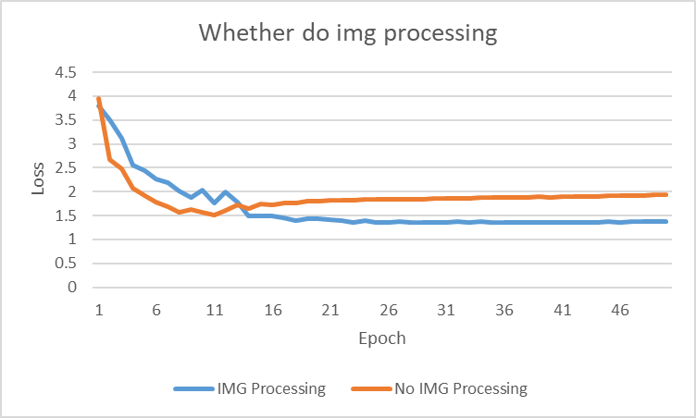
Whether do image processing(Based on CIFAR-100)
Acc=> 66.6% vs 64.8%
The test data set does not have graphics that are too difficult to distinguish, therefore, the image processing reduces the accuracy at the beginning.
Doing image processing can effectively reduce the loss function in the end

Slide 9
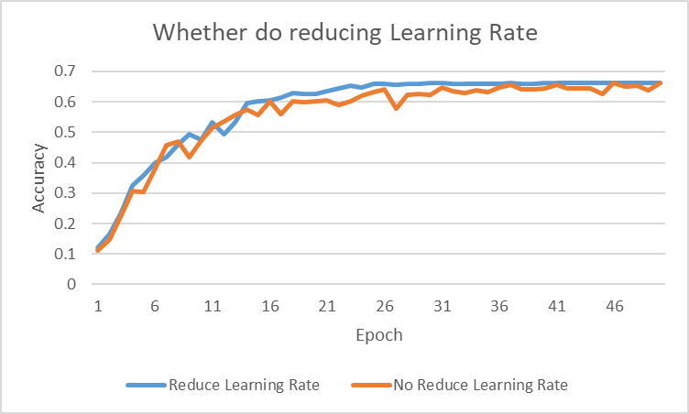
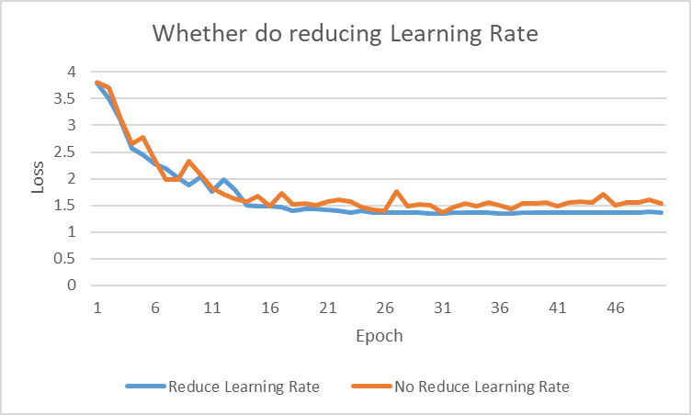
Whether do reducing learning rate(Based on CIFAR-100)
The loss function is jittering if we don’t use reducing learning rate

Slide 10
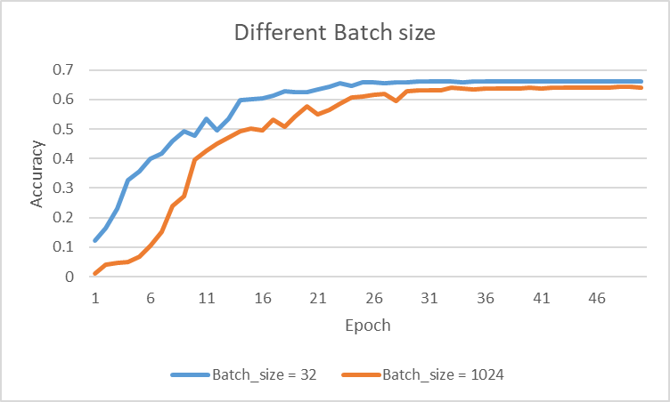
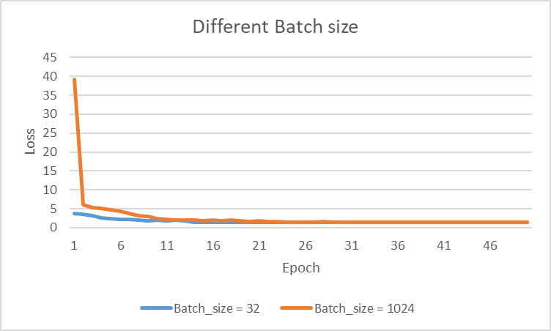
Different Batch Size(Based on CIFAR-100)
Notice :
When the amount of data is large enough, you can reduce the batch size appropriately.
When the batch size is too small and the number of categories is relatively large, it may cause the loss function to oscillate without convergence.
Therefore, If the dataset is relatively small, then the full dataset can be used
As the batch size increases, the number of epochs required to achieve the same loss function becomes more and more.

Slide 11
Thank you

